Slide 1
Steps to create s3 buckets in AWS

Slide 2
Amazon S3 Buckets: Amazon Simple Storage Service (S3) is an object storage service that allows you to store and retrieve any amount of data from anywhere on the web. It is highly scalable, durable, and secure.

Slide 3
What is an S3 Bucket? An S3 bucket is a container for storing objects (files, images, videos, backups, etc.) in AWS. Think of it like a folder in the cloud but with extra security, access controls, and versioning features.

Slide 4
📂Key Features of S3 Buckets: 1. Unlimited Storage – You can store as much data as needed. 2. Scalability – Scales automatically based on your data needs. 3. High Durability (99.999999999%) – AWS replicates data across multiple availability zones. 4. Access Control – You can control who can read/write using IAM policies. 5. Encryption – Supports data encryption at rest (SSE-S3, SSE-KMS) and in transit (SSL/TLS). 6. Versioning – Keeps previous versions of files to protect against accidental deletion. 7. Lifecycle Policies – Moves data to cheaper storage classes (like Glacier) to reduce costs. 8. Static Website Hosting – You can host simple websites directly from an S3 bucket.

Slide 5
🗄️S3 Storage Classes (Cost Optimization):
Storage Class | Use Case
S3 Standard | Frequently accessed data
S3 Intelligent-Tiering | Auto-moves data between Standard & IA
S3 Standard-IA | Infrequently accessed data (lower cost)
S3 One Zone-IA | Lower-cost, single AZ storage
S3 Glacier | Long-term archival storage
S3 Glacier Deep Archive | Cheapest, for cold storage (rarely accessed)

Slide 6
🔒 Security in S3: 1. IAM Policies → Restrict access to users and roles. 2. Bucket Policies → Control access to the whole bucket. 3. Public Access Block → Prevent accidental public access. 4. Encryption → Protects data at rest and in transit.

Slide 7
💡 Common Use Cases ✅ Backup & Restore ✅ Website Hosting (Static websites) ✅ Big Data & Analytics ✅ Software Distribution ✅ Media Storage & Streaming ✅ Disaster Recovery

Slide 8
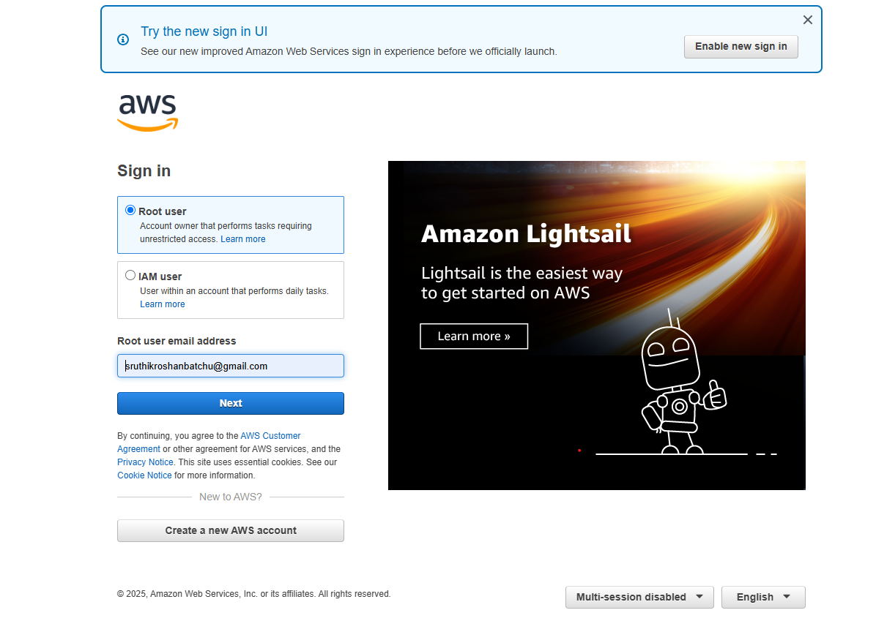
🔹 Step 1: Log in to AWS Console 1. Go to AWS Management Console. 2. Log in with your AWS account credentials.

Slide 9
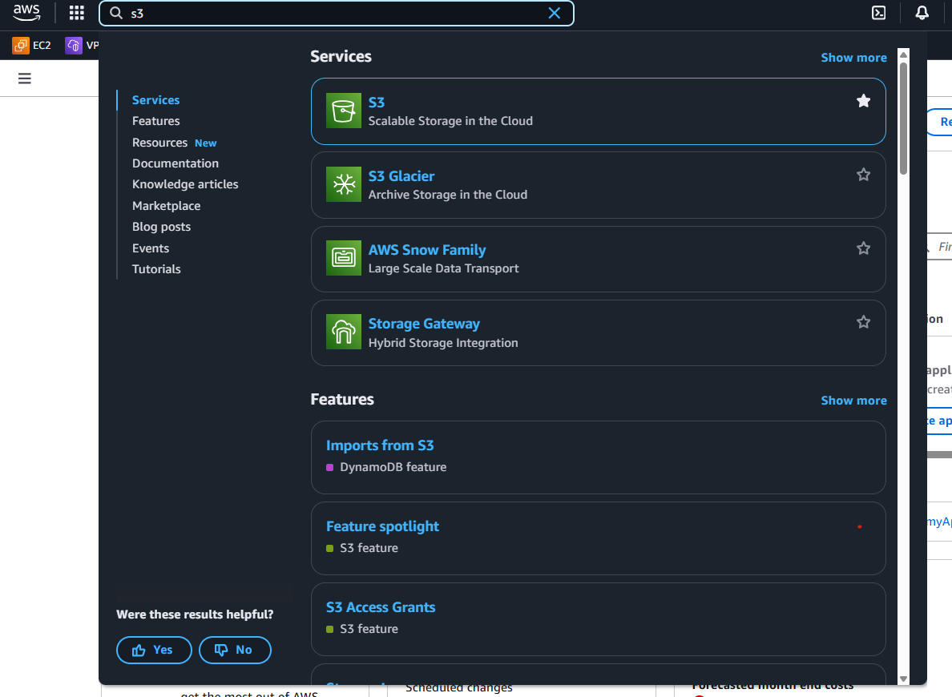
🔹 Step 2: Open S3 Service 1. In the AWS console, search for "S3" in the top search bar. 2. Click on "S3" to open the S3 dashboard.

Slide 10
🔹 Step 3: Create a New S3 Bucket
Click "Create bucket" (blue button).
Fill in the details:
Bucket name: (e.g., my-ascus-bucket)
AWS Region: Select a region closest to your users (e.g., us-east-1).
Block Public Access: (Keep enabled for security).
Versioning: (Enable if needed to keep previous versions of files).
Encryption: (Optional – you can enable SSE-S3 for default encryption).
Click "Create bucket".

Slide 11
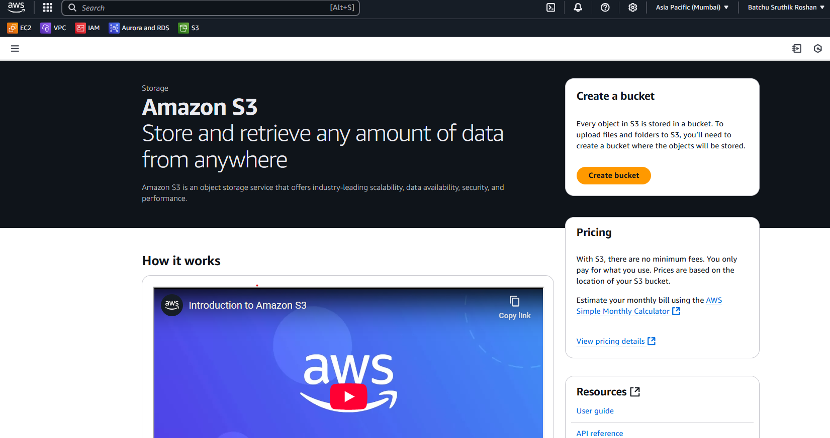

Slide 12
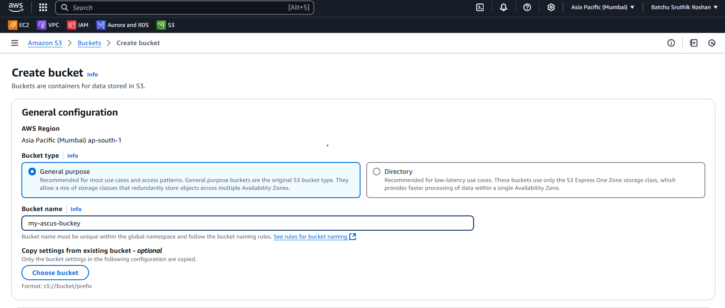

Slide 13
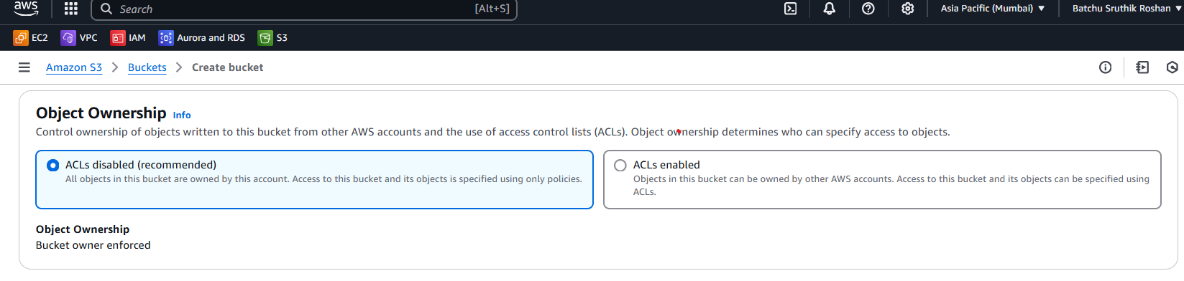

Slide 14
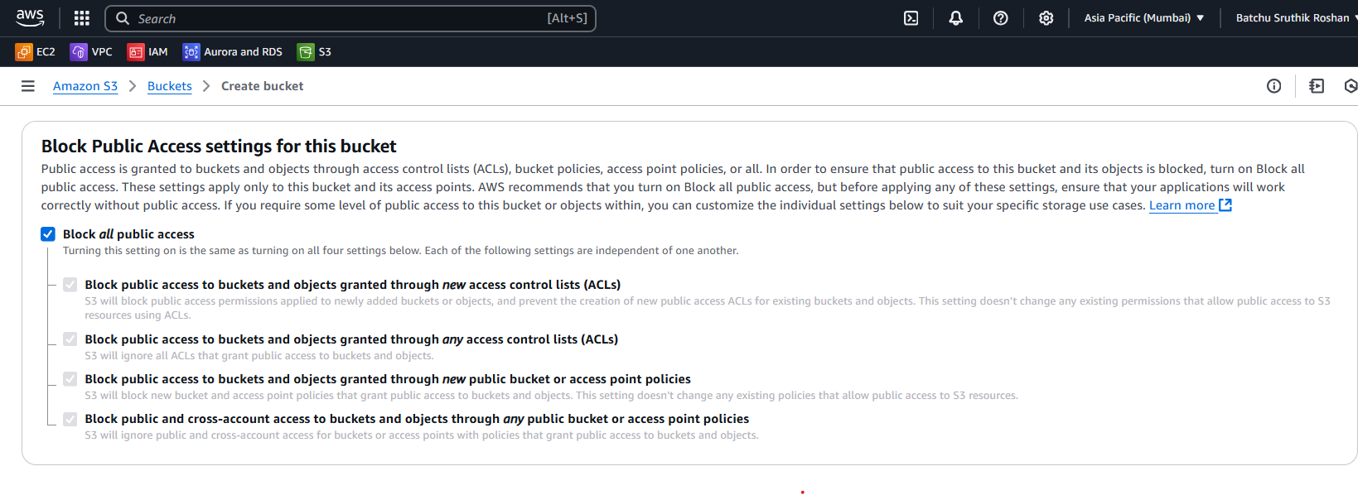

Slide 15
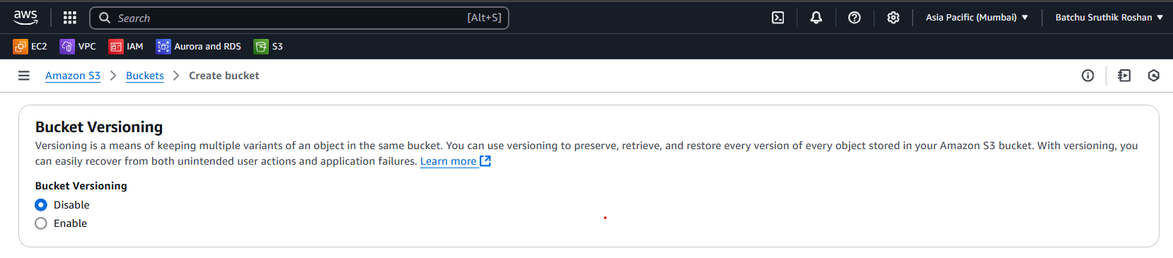

Slide 16
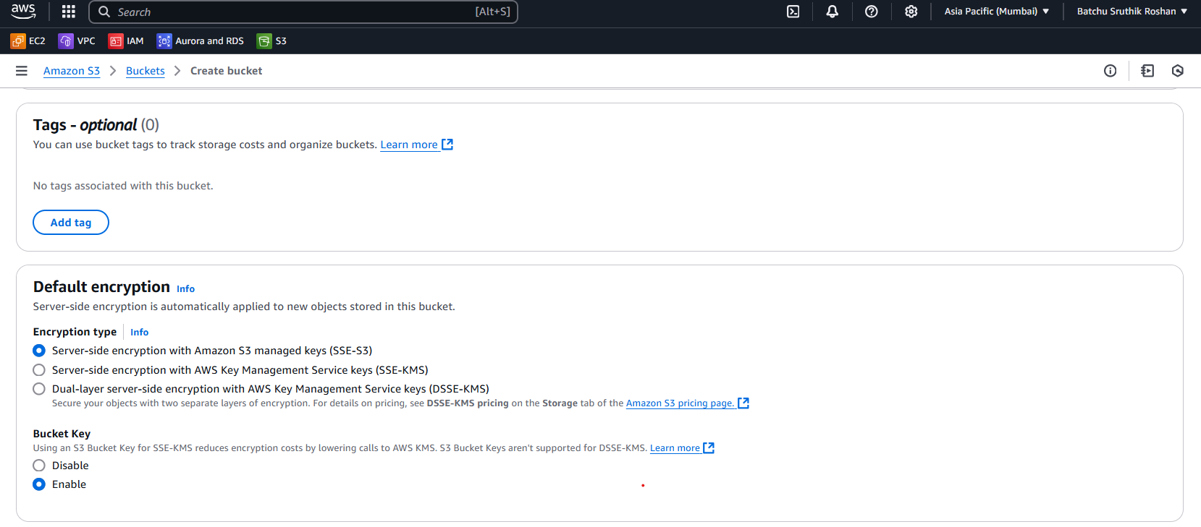

Slide 17
